Slide 1
Angular 4

Slide 2
Evolution of JavaScript based Frameworks
JavaScript was initially called LiveScript.
JavaScript was initially designed to perform validations and simple dynamic operations in browsers.
JavaScript started following ECMA Script Standard Specifications. ECMA stands for European Computer Manufacturers Association.
Initial features of JavaScript, were not sufficient to develop Huge Applications.
However new Features being introduced in ES 5, and ES6, and JavaScript further being compliant with latest standards, made JavaScript possible to use for Huge Applications.

Slide 3
JavaScript: Why so Popular
1. Simple — JavaScript has become so widespread as basics are simple and easy to learn
2. Extensible — Javascript can be coupled with many powerful tools that give it a ton of utility: JSON, AJAX, Nodejs, MongoDB, jQuery.
AJAX improves user experience by displaying web page to User, and parallely loads a portion of Webpage, and jQuery gives it an extensive code library that makes writing complex Javascript much quicker/easier.
3. Accessible — Runs in a browser so you don’t need to download it in order to use it. All you need is a text editor.
4. Widerange- JavaScript can also be used to develop Mobile Applications

Slide 4
ES6 Features
Languages like JavaScript, Jscript and ActionScript are governed by ES6 specification.
The specification is also influenced by other programming languages like Perl, Python, Java etc.
Below are some of features of ECMA Script6:
Support for constants
Block Scope
Arrow Functions
Extended Parameter Handling
Template Literals

Slide 5
ES6 Features…
Enhanced Object Properties
De-structuring Assignment
Modules
Classes
Collections
Promises

Slide 6
ES6
function fun1(...params) { //Rest Parameters
console.log(params.length);
}
fun1();
fun1(5);
fun1(5, 6, 7);
Function Constructor

Slide 7
ES6
Lambda refers to anonymous functions in programming. Lambda functions are a concise mechanism to represent anonymous functions. These functions are also called as Arrow functions.
Lambda Function - Anatomy
There are 3 parts to a Lambda function:
Parameters: A function may optionally have parameters.
The fat arrow notation/lambda notation (=>): It is also called as the goes to operator.

Slide 8
ES6
Statements: Represents the function’s instruction set
Tip: By convention, the use of a single letter parameter is encouraged for a compact and precise function declaration.
Lambda Expression It is an anonymous function expression that points to a single line of code. Following is the syntax for the same.
( [param1, parma2,…param n] )=>statement;

Slide 9
ES6 - Collections
ES6 introduces two new data structures: Maps and Sets.
Maps: This data structure enables mapping a key to a value.
Sets: Sets are similar to arrays. However, sets do not encourage duplicates.

Slide 10
ES6 – Enhanced object Literals
Consider the following ES 5 fragment:
function createMonster(name, power)
{
return { type: 'Monster', name: name, power: power };
}
With the new shorthand form, this can be rewritten as the following code:
function createMonster(name, power)
{
return { type: 'Monster', name, power };
}

Slide 11
ES6 - Promise
"Imagine there is a kid. And mom promises him that she'll get him a new phone next week.“
That is a promise. A promise has 3 states. They are:
Promise is pending: He don't know if you will get that phone until next week.
Promise is resolved: His mom really buys him a brand new phone.
Promise is rejected: He don't get a new phone because your mom is not happy.

Slide 12
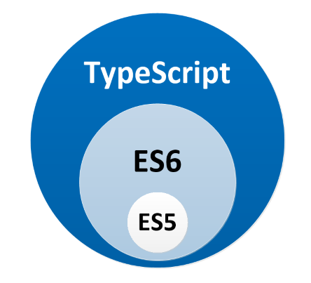
TypeScript is superset of ES6
https://www.typescriptlang.org/
TypeScript is developed by Microsoft
TypeScript is a typed superset of JavaScript that compiles into a plain JavaScript
TypeScript is JavaScript that scales

Slide 13
TypeScript - Features
TypeScript, a typed superset of JavaScript that compiles to plain JavaScript.
It supports all ECMAScript 6 features - arrow functions, classes, enhanced object literals, modules, generators, iterators, etc. and adds new features, not currently in the spec of ECMAScript at all like:
Type Annotations or Decorators
Interfaces
Enums
Encapsulation with public, private and protected modifiers
Tuple
Namespaces
Generics

Slide 14
Basic Datatypes in TypeScript
Below are basic or built in data types in TypeScript
1. boolean
2. number
height: number = 99;
3. string
name: string = “abcdef";
4. any
xyz: any = 4;
5. array
abc:number[] = [1, 2, 3];
6. enum
7. void

Slide 15
TypeScript - Static Types - Advantage
The static typing is one of the most power tools TypeScript provide.
Its benefit is to enable IDEs to provide a richer environment for spotting common errors as you type the code.
In a large JavaScript project, this leads to more robust and easier to maintain code.
Bugs that are caused by false assumptions of some variable being of a certain type can be completely eradicated.

Slide 16
TypeScript
TypeScript is optionally typed by default. For example:
function sum(x) { return x + y };
This is a valid function in TypeScript which can be called with any kind of parameter.
TypeScript is smart enough to implicitly assign the type any before compilation.
There is a --noImplicitAny flag, which will disallow this behavior.
Enabling above flag gives you a greater degree of safety, but also means you will have to do more typing.
Types have a cost associated with them. There is a certain learning curve and it will cost you a bit of time to setup a codebase with the proper strict types.

Slide 17
TypeScript – Why to use?
There are several advantages of using TypeScript :
Better readable code
Easier to analyse code
More reliable refactoring
Early detection of errors

Slide 18
TypeScript – When to choose
When choosing TypeScript, you need to analyze few points:
Is your codebase large enough to the point of being difficult to maintain and refactor?
As mentioned above, TypeScript has a learning curve, that your development team needs to go through.
Are you OK with some potential performance penalties?
TypeScript compiler has features that require generating extra code (inheritance, enum, generics, async/await, etc). No matter how good the compiler is, it can’t surpass the optimizations of a good programmer.
Are you OK with the introduced cost?
Starting fresh with TypeScript or migrating a codebase to TypeScript comes with a cost. You will have a period, where the development process with slow down and most of the members of the team, new to TypeScript can feel anxious. This is absolutely normal at first, but it's better to cope with this problems as fast as possible.

Slide 19
TypeScript – When to choose…
Migrating JavaScript to TypeScript
Migrating JavaScript to Typescript can be optimally done incrementally.
TypeScript 1.8 introduces a flag called --allowJs - TypeScript will run a quick sanity check on all .js files for syntax errors but otherwise passes them straight through to the output directory.
After that, you can easily migrate all other .js files to .ts. You will most certainly have to fix the compilation typing errors, but this will be pretty straightforward in most cases.
Conclusion
Using TypeScript has more advantages than disadvantages in general

Slide 20
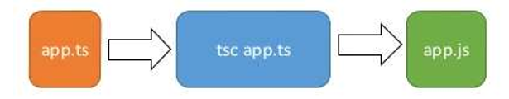
TypeScript Compilation Process
Sample ts file
Transpile .ts to .js, using tsc
Final JavaScript file
As shown above, TypeScript is compiled(or transpiled) into JavaScript file, which can be further executed on Browser
How to install TSC Transpiler?
After installing Node.JS,please give below command to install TypeScript Transpiler
npm install -g typescript

Slide 21
How to compile ts file
tsc simple1.ts
Above command generates simple1.js file, which can be executed, from command line, as below
node simple1.js
Ts file can be transpiled, online also, at below URL
http://www.typescriptlang.org/play/

Slide 22
TypeScript Access Specifiers
The supported access modifiers by TypeScript are:
Public: public members can be accessed any where.
Private: private members can only be accessed within that class itself.
Protected: protected members can be accessed from inside the class or any other class extending the one that owns the property or the method.
Default Access specifier is public

Slide 23
TypeScript - Decorators
A Decorator is a special kind of declaration that can be attached to a class declaration, method, property, or parameter.
Decorators use the form @expression, where expression must evaluate to a function that will be called at runtime with information about the decorated declaration.

Slide 24
TypeScript namespace & Modules
Another important feature of TypeScript, not directly available in JavaScript is namespace & Modules.
Below is simple snippet showing the same
/// <reference path = "IShape.ts" />
namespace Drawing {
export class Circle implements IShape {
public draw() {
console.log("Circle is drawn");
}
}
}

Slide 25
TypeScript namespace & Modules
Modules are executed within their own scope, not in the global scope; this means that variables, functions, classes, etc. declared in a module are not visible outside the module unless they are explicitly exported using export.
Conversely, to consume a variable, function, class, interface, etc. exported from a different module, it has to be imported using import.
Modules are declarative; the relationships between modules are specified in terms of imports and exports at the file level.

Slide 26
TypeScript Module Export & Import
How to Export?
export interface StringValidator
{
isAcceptable(s: string): boolean;
}
How to import?
//Import a single export from a module
import { ZipCodeValidator } from "./ZipCodeValidator";
//imports can also be renamed
import { ZipCodeValidator as ZCV } from "./ZipCodeValidator";
//Import the entire module into a single variable
import * as validator from "./ZipCodeValidator";

Slide 27
TypeScript Interface
As known, it is possible to declare interfaces in TypeScript, which can further have one or more implementations
Questions
TBD

Slide 28
TypeScript Generics
Generics improves code reusability.
TypeScript supports generics, just like other OO Languages, like Java, C++(templates), etc…
Below is an example how to declare Generics
function geg<T>(arg: T): T { return arg; }
How to use above Generic, with a specific type string
let output = geg<string>("myString");

Slide 29
Difference between var and let keywords
function fun1()
{ //abc is *not* visible out here
for( let abc= 0; abc< 5; abc++ )
{
//abc is only visible in here (and in the for() parentheses)
//and there is a separate abc variable for each iteration of the loop
}
//abc is *not* visible out here
}
function fun2()
{ //xyz *is* visible out here
for( var xyz= 0; xyz< 5; xyz++ )
{
//xyz is visible to the whole function
}
//xyz *is* visible out here
}
Scope of let
Scope of var

Slide 30
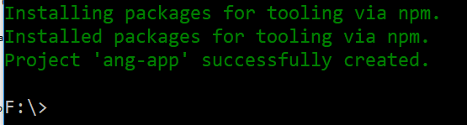
Angular 4 Development Environment Setup
Install Node JS and npm (Minimum version node 6.9.x and npm 3.x.x by running node -v and npm –v)
Install the Angular CLI globally.
npm install -g @angular/cli
Create a new project
ng new my-app
Go to the project directory and launch the server.
cd my-app
ng serve --open

Slide 31
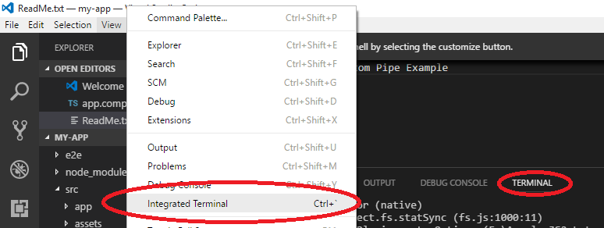
Visual Studio Code IDE Setup
Visual Studio Code 1.1x(or later) can be installed, for TypeScript code Development.
To build and run ng Commands, follow below steps

Slide 32
What is Angular 2/4
Angular 2/4 has been developed by the same team who developed the famous angularJS, bring hard learned lessons of AngularJS into Angular 2/4.
Angular 2/4 is more of an ALL IN ONE framework. So, it gives you everything to create a single website, rather than using multiple JS Frameworks.
Below are Angular 2/4 features:
Angular 2/4 uses TypeScript: TypeScript is developed by Microsoft and is supported by angular 2/4. It introduces static types which makes things like IDEs and builders/compilers more effective. In some scenarios it also makes writing testing your code easier.

Slide 33
Advantages of Angular 2/4(over Angular JS)
Modular: Angular apps are quite modular i.e. organising your code into independent chunks or buckets such that each of such bucket offers similar kind of functionality.
This makes testing, upgradation and maintenance of the app a lot more convenient.
Enterprise applications tends to grow quite large and need to be maintainable, which is definitely achievable with Angular.
Scalable
Better Performance and Mobile Friendly
Can also be used to develop Native Applications for Desktop and Mobile

Slide 34
Disadvantages of Angular 2/4
Though AngularJS comes with a lot of merits, here are some points of concern:
Not secure : Being JavaScript only framework, application written in AngularJS are not safe. Server side authentication and authorization is must to keep an application secure.
Not degradable: If the user of your application disables JavaScript, then nothing would be visible, except the basic page.

Slide 35
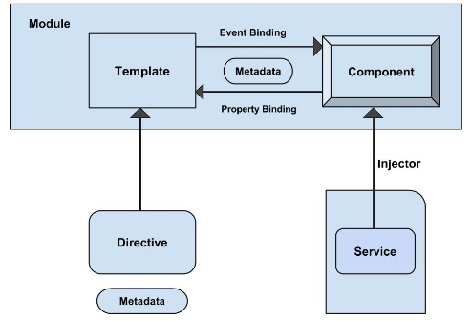
Angular 2/4 Architecture

Slide 36
Naming Convention of files
.ts files indicates they are TypeScript Files
Filename | stores
car.module.ts | Car Module
car.component.ts | Car Component
car.component.html | Car html Template(View)
car.component.css | CSS Styling for car component
car.service.ts | Car Service
car.routes.ts | Car Routings
car.pipe.ts | Custom Pipe Implementations
car.spec.ts | Code to Test Car component
Interface file names generally prefixed with I

Slide 37
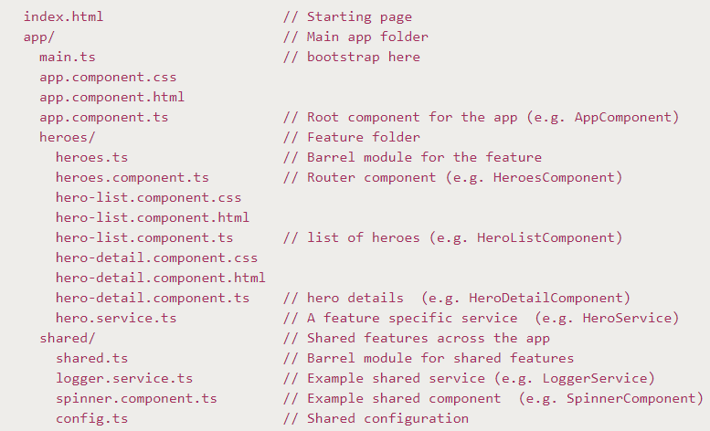
Sample File Structure

Slide 38
Anatomy of AngularJS 2/4 App
Below shows the anatomy of an Angular 2/4 application.
Each application consists of Components.
Each component is a logical boundary of functionality for the application.
You need to have layered services, which are used to share the functionality across components.
Component1
Component2
Component3
Service

Slide 39
What a Component comprises?
A component consists of:
Template: This is used to render the view for the application. This contains the HTML that needs to be rendered in the application. This part also includes the binding and directives.
Class: This contains properties and methods. This has the code which is used to support the view. It is defined in TypeScript.
Metadata: This has the extra data defined for the Angular class. It is defined with a decorator
Component
UI Template
Class
Metadata

Slide 40
Component Code Snippet
import { Component } from '@angular/core';
@Component({
selector: 'demo-app',
templateUrl: 'app/app.component.html'
})
export class AppComponent{
//property
appTitle: string = 'Welcome';
//constructor
//methods
}
Html tag
Value given to property
Data type of property
Name of property

Slide 41
Component Code Snippet
templateUrl: The templateUrl contains the path to the HTML file. The Angular uses this HTML file to render the view. In above example it is app/app.component.html
styleUrls: The styleUrls is an array of Style Sheets that angular2 uses to style our HTML file.
Selector: The selector tells angular, where to display the template. In the example above selector is “’demo-app’”. The angular whenever it encounters the above tag replaces it with the template

Slide 42
Components – and Advantages
An Angular 2/4 Application consists of many such Components, which improves
Re Usability
Maintainability
Scalability
Etc…

Slide 43
Module
An application is made up of modules.
Each Angular 2/4 application needs to have one Angular Root Module.
Each Angular Root module can then have multiple components to separate the functionality
Module
Component1
Component2
Component3

Slide 44
Module Code Snippet
import { NgModule } from '@angular/core';
import { BrowserModule } from '@angular/platform-browser';
import { AppComponent } from './app.component';
@NgModule({
imports: [ BrowserModule ],
declarations: [ AppComponent ],
bootstrap: [ AppComponent ]
})
export class AppModule { }
Array of components/Modules used by this Module
Array of components declared by this Module
Bootstrap component
Name of Module

Slide 45
Root Module
Every Angular application requires at least one module called a root module. Root Module is also responsible for loading other parts of our app and any Angular-specific dependencies.
NgModule imports general Module code from the Angular framework's core.
BrowserModule imports code necessary to run our app in the browser, including built-in directives that allow us to add things like conditionals and loops to our components.
AppComponent actually refers to the root component, which we need to create.

Slide 46
Module
@NgModule decorator specifies the code following, belongs to Module.
imports (the one directly below @NgModule) is an array of other modules and content this module requires. Here, we import a built-in module called BrowserModule.
declarations is an array of all components that will reside in this module.
And "bootstrap" refers to component, which need to be initially loaded.

Slide 47
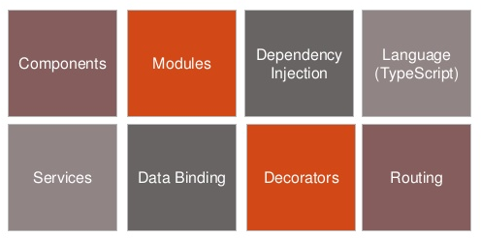
Angular JS2/4 Core Concepts

Slide 48
Angular 2/4 - MVW
Angular 2/4 is more of component based architecture.
You can assume everything as component like directives, services, Pipes and so on.
A component contains of, a view details and class declaration which may be considered as controller.
So a well defined component consist of individual set of MVC architecture.

Slide 49
Angular 2/4 - MVW
MVW stands for Model View Whatever
AppComponent class is equivalent to the controller class and is thus your W.
View is the components HTML Template
Model is the services that can be provided / injected.
Whatever it is, it separates Concerns for us, producing modular and maintainable code

Slide 50
Metadata
Metadata is used to decorate a class so that it can configure the expected behavior of the class.
Metadata is specified using Annotations
Below are few Annotations
@Component
@Routing
@Environment
@Injectable

Slide 51
What is Template?
A Template specifies View which will be rendered on webpage.
A Template can be specified either as inline or as URL
@Component({
selector: 'my-app',
template: `
<h1>{{title}}</h1>
<h2>My favorite hero is: {{myHero}}</h2>
`
})
{{1 + 1}} {{met()}}
Inline template
Property of component

Slide 52
Data Binding
Data binding is the connection bridge between View and the business logic (View Model) of the application.
Data binding in Angular is the automatic synchronization between Model and the View.
When the Model changes, the Views are automatically updated and vice-versa.
Following are the types of data binding in Angular 2/4.
Interpolation {{ }}
One-way binding [ ]
Two-way binding [( )]
Event binding ( )

Slide 53
Data Binding - Interpolation {{ }}
Easiest way of data binding in Angular 2/4.
In interpolation, we need to supply property name in the View template, enclosed in double curly braces, e.g. {{name}}.
It is used for one-way binding (Component class to View only).

Slide 54
Data Binding - Interpolation {{ }}
app.component.ts
import { Component } from '@angular/core';
@Component({
selector: 'test-app',
templateUrl: './app/databinding.html'
})
export class AppComponent {
name = ‘Sample Text Here';
}
databinding.html
<h4>Data binding in Angular 2/4 Application</h4>
<div>
<h5>Interpolation Example</h5>
Hello {{name}}
</div>

Slide 55
Data Binding – One-way Binding
In Angular 2/4, one-way data binding directive is replaced with [property].
Angular 2.0 uses HTML DOM element property for one-way binding.
square brackets are used with property name for one-way data binding in Angular 2/4.
For example, if we want one-way binding from Model property to template View for textbox, we need to use [value]

Slide 56
Data Binding – One-way Binding [ ]
app.component.ts
import { Component }
from '@angular/core';
@Component({
selector: 'test-app',
templateUrl: './app/databinding.html'
})
export class AppComponent {
name = ‘Test Purpose';
welcomeText = 'Welcome All!'
}
databinding.html
<div>
<h5>One way binding Example</h5>
Hello <span [innerText] = "name" ></span>!
<br/><br/>
<input type = 'text' [value]="welcomeText" />
</div>

Slide 57
Data Binding – One-way Binding
Below are some more examples, which shows that Angular 2.0 uses HTML DOM element property for one-way binding
<option [selected]="isCarSelected" value="BMW">BMW</option>
<p [style.color]="red”>Carlos Menezes</p>

Slide 58
Data Binding – Two-way Binding ngModel
[(ngModel)] is used for this, in Angular 2/4.
The ngModel directive is part of a built-in Angular module called "FormsModule".
We must import this module in to the template module before using the ngModel directive.
databinding.html
<div>
<h5>Two way binding Example</h5>
Enter Name: <input [(ngModel)]="enterName" />
<br/><br/>
<span> WelCome {{enterName}} ! </span>
</div>

Slide 59
Two-way Data Binding, without ngModel
Angular 2/4 has a feature called "template reference variables“, with which we can have direct access to an element, within the Template.
The template reference variable is declared by preceding an identifier with a hash/pound character (#). In the following example, we have declared a template reference variable named "txtName" on the input element.
txtName is not bind to the component.
<div>
<h5>Two way binding (without ngModel directive) Example</h5>
Enter you Name: <input #txtName type = "text" (keyup)="0" />
<br/><br/>
<span> WelCome {{txtName.value}} ! </span>
</div>

Slide 60
Event Binding
Angular 2/4 directly uses the valid HTML DOM element events.
round brackets (parentheses) are used with DOM event name for event binding in Angular 2/4. For eg: (click)
app.component.ts file
import { Component }
from '@angular/core';
@Component({
selector: 'test-app',
templateUrl: './databinding.html'
})
export class AppComponent {
messageText = '';
onClickMe() {
this.messageText = "Hi there";
}
}
databinding.html file
<div>
<h5>Event binding Example</h5>
<button (click)="onClickMe()">Click Here </button>
<br/><br/>
<span> {{messageText}} </span>
</div>

Slide 61
What all we can use in Template?
In a template we can use
HTML Tags
Template Expressions
Directives, which has a specific purpose
Below are inbuilt directives
ngIf
ngFor
ngSwitch
ngClass
ngModel

Slide 62
ngIf Directive
NgIf is a directive that is used to add an element subtree to the DOM on the basis of true value of an expression.
If the value of expression is false then the element subtree will be removed from the DOM.
To use NgIf we need to prefix it with asterisk (*) as *ngIf. Hiding and displaying element subtree using
CSS visibility property is not same as work done by NgIf.
CSS visibility property does not remove element subtree from DOM, whereas NgIf removes the element subtree from DOM for false value of expression.

Slide 63
ngIf Directive
CSS visibility property does not physically remove the element subtree when hiding, so it continues to consume resources and memory that will affect the performance.
In case of NgIf it physically removes element subtree, so it does not consume resources and memory which in turn results into better performance.
NgIf is used with HTML elements as well as component elements.

Slide 64
ngIf example
Simple ngIf example
<div *ngIf="isValid"> Data is valid</div>
NgIf is used with component elements as follows.
<my-msg *ngIf="emp1" [pname] = "emp1.name"> </my-msg>
NOTE: Data is valid is shown on Web page only if isValid is true
NOTE: my-msg element is rendered on web page only if emp1 is true or has some value

Slide 65
ngFor Directive
NgFor is a directive that iterates over collection of data.
Whenever there is change in collection of data at runtime, that will be updated in data display iterated by NgFor directive.
NgFor provides local variables that will help to get index of current iteration, detect if element in iteration is first or last and odd or even.

Slide 66
ngFor Directive
NgFor is used with HTML element as well as component element.
NgFor with HTML element iterates the template within it.
NgFor with component element iterates the child component HTML template.
NgFor can be used with asterisk(*) or template directive or template tag.

Slide 67
ngFor Directive …
Finding the index position of an element
using even and odd
Identifying first and last element of a list
Questions:
Give Background yellow, for odd elements and green for even elements
Give grey background for first and last elements

Slide 68
*ngIf and Else
One addition in Angular 4, is the “else” statement. If this, else that. Nice and simple. In AngularJS we’d have to negate the expression to evaluate to an “else”, and templates became a little messy at times.

Slide 69
ngSwitch
NgSwitch is used to display one element tree from a set of many element trees based on some condition. It uses three keywords as follows. ngSwitch: We bind an expression to it that returns the switch value. It uses property binding. ngSwitchCase: Defines the element for matched value. We need to prefix it with asterisk (*). ngSwitchDefault: Defines the default element when there is no match. We need to prefix it with asterisk (*). Find the code snippet for NgSwitch with bracket [ ].

Slide 70
ngSwitch
<ul [ngSwitch]="person">
<li *ngSwitchCase="'Mohan'">Hello Mohan</li>
<li *ngSwitchCase="'Sohan'">Hello Sohan</li>
<li *ngSwitchCase="'Vijay'">Hello Vijay</li>
<li *ngSwitchDefault>Bye Bye</li>
</ul>

Slide 71
ngStyle
Using ngStyle we can easily style multiple properties of our element.
We also can bind these css properties to variables that can be updated by the user or our components.
<div [ngStyle]="{'color': 'blue', 'font-size': '24px', 'font-weight': 'bold'}">
style using ngStyle
</div>
<div [ngStyle]="{'color': color, 'font-size': size, 'font-weight': 'bold'}">
style using ngStyle
</div>
<input [(ngModel)]="color" />
<button (click)="size = size + 1">+</button>
<button (click)="size = size - 1">-</button>
Normal CSS Style Tags
Variables whose values can be changed by user or component
Two way binding with color variable
Size gets changed when use clicks + or -button

Slide 72
ngClass
It is used to add and remove CSS classes on an HTML element, dynamically.
We can bind several CSS classes to NgClass simultaneously that can be added or removed.
There are different ways to bind CSS classes to NgClass that are using string, array and object. CSS classes are assigned to NgClass as property binding using bracket i.e [ngClass] as attribute of any HTML element .
We can assign one or more than one CSS classes to HTML element using NgClass.

Slide 73
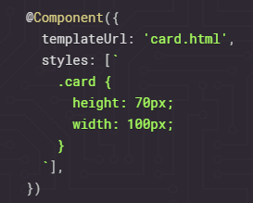
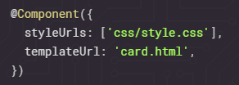
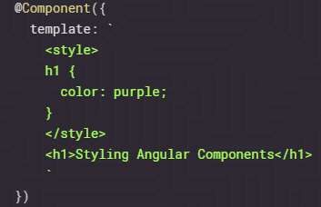
How to specify Styling details?
1. Component Inline Styles
It is implemented in the
@Component decorator of
our component class.
2. External Stylesheets
Using styleUrls
3.Template Inline Styles
Within HTML Template

Slide 74
Questions
Display Helloworld with a shade using above different ways of styling

Slide 75
Angular 2/4 Model Classes
Yes, we can have Model classes. These Model classes can have only data members
export class Hero
{
id: number;
name: string;
}
Model class can be data member, parameter to a function, etc…

Slide 76
Module
How many components a Module can have?
A Module can import how many other Components?

Slide 77
Comments
Comments in Template
<!-- -->
Comments in ts file
//single line comment
/*muti line comment
*/
Comments in css file

Slide 78
Custom Directive
Angular provides three types of directive:
Component directive,
Attribute directive
Structural directive.
Component directive is used to create HTML template.
Attribute directive changes the appearance and behavior of DOM element.
Structural directive changes the DOM layout by adding and removing DOM elements.

Slide 79
Builtin Directive
Angular also provides built-in directives.
The built-in Attribute directives are NgStyle, NgClass etc. These directives change the appearance and behavior of HTML elements.
The built-in Structural directives are NgFor and NgIf, etc.

Slide 80
Custom Directive
As an example let see how to create custom attribute and structural directives.
In angular we create these directives using @Directive() decorator.
It has a selector metadata that defines the custom directive name.

Slide 81
How to create Custom Directive
Custom directives are created using following syntax.
@Directive
({ selector: '[cpDir]' })
export class CPDirective { }
The directive name is cpDir here. It should be enclosed within bracket [ ]. We can keep directive name as we want but it should be started with your company or project name.
To behave our directive like attribute directive, we can use ElementRef to change appearance.
To listen event we can use @HostListener() decorator.
To behave our directive like structural directive, we can use TemplateRef and ViewContainerRef.

Slide 82
Pipes
Why pipes | ?
A Pipe denoted by vertical bar | is used to
transform data from one form to another
Filter data items in a list
A Pipe is generally used in Template
Pipes don’t give you any new feature. In angular 2/4 you can use logics in templates too. You also can execute a function in the template to get its returned value.
Usage of pipes
You can display only some filtered elements from an array.
You can modify or format the value.
You can use them as a function.
You can do all of the above combined.

Slide 83
Pipes
Pipes is a handsome way to handle these things in templates. It makes your code more clean and structured.
General syntax of Pipe usage(in templates)
myValue | myPipe
myValue | myPipe:param1:param2
There are some built in Pipe, and of course we can create customized Pipes

Slide 84
Inbuilt Pipes
Pipe Usage | Description
str | lowercase str | uppercase | Converts string to lower or upper case
obj | json | print the object in JSON format
str | slice:0:4 | Splits the given str
pi | number:'.3-3' | number format pipe, display at least 3 digits after decimal, and not more than 3 digits
b | currency:'INR':false:'4.2-2' | second parameter it takes is symbolDisplay whose default value is false. The third parameter is digitInfo which works as DecimalPipe.
promise | async | works as an observer to a promise. If the promise is resolved.

Slide 85
Pipes
params for that particular pipe can be sent separated by colon (:) symbol. The order of execution is from left to right.
The pipe operator only works in your templates and not in JavaScript code.
In JavaScript the pipe symbol works as bitwise operator.
Code example
import {Component, View} from 'angular2/core';
@Component({
selector: 'date-pipe',
})
@View({
template: `
<h2>Pipe Example</h2>
<h4>1. Today is {{today}}</h4>
<h4>2. Today is {{today | date}}</h4>
<h4>3. Today is {{today | date:"dd/MM/yyyy"}}</h4>
`
})
export class DatePipe {
today = new Date();
}

Slide 86
How to create custom Pipes
Along with using inbuilt pipes, it is also possible to create custom pipes. Below are steps for same
step 1: Create a typescript class named as WelcomePipe. step 2: Import Pipe and PipeTransform interface from angular core module. step 3: Decorate WelcomePipe with @Pipe . Its name metadata will define custom pipe name. step 4: WelcomePipe will implement PipeTransform interface. step 5: Override transform() method of PipeTransform interface. The parameter of transform() can be of any type. In our example we are using string data type and return type is also a string. Here we will perform task which needs to be done by our custom pipe and return the result. This is the result which will be returned by custom pipe. step 6: To make custom pipe available at application level, declare WelcomePipe in @NgModule decorator. In our example module file is module.ts.

Slide 87
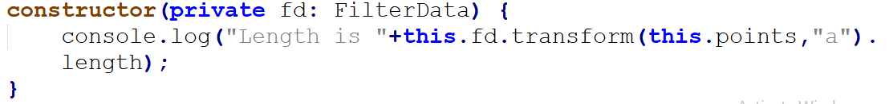
Can we invoke Pipe in Component code, instead of in template?
Yes, it is possible to invoke Pipe from Component or Service code, as shown below
Step 1. Create pipe’s object thru Dependency Injection, from Constructor
Step 2. Invoke transform() method, with the object of any pipe, pass input data and additional parameters

Slide 88
Service
A service is used when a common functionality needs to be provided to various modules.
For example, we could have a database functionality that could be reused among various modules.
And hence you could create a service that could have the database functionality.
Module 1
Module 2
Module 3
Services

Slide 89
Steps to create Service
Following are steps to create a service.
Step 1 − Create a separate class which has the injectable decorator.
The injectable decorator allows the functionality of this class to be injected and used in any Angular JS module.
@Injectable()
export class classname { }
Step 2 − Next in your appComponent module or the module in which you want to use the service, you need to define it as a provider in the @Component decorator.
@Component ({
providers : [classname]
})

Slide 90
What is Promise?
Promises are used to handle Asynchronous activities, and generally used in Services.
Whenever a time consuming activity need to be performed, promise can be used by providing success/failure functions, and further Main application can keep proceeding with other activities.

Slide 91
What is Promise?
States of a promise
At any time, a promise can be in one of these three states –
1. Pending
A promise is pending when you start it. It hasn’t been resolved or rejected. It is in a neutral state.
2. Fulfilled
When the operation is successful, a promise is considered fulfilled or resolved.
3. Rejected
If an operation fails, the promise is rejected.

Slide 92
Promise Code Snippets
getServiceWithMultipleQueryTerm(url: string, query: string): Promise<any>
{
return this.http .get(url + "/?" + query, this.options).toPromise()
.then(this.extractData)
.catch(this.handleError);
}
Create Promise
Execute if Successful
Execute if Failure

Slide 93
Http- Ajax

Slide 94
Forms
A large number of Front-end Applications need a number of forms, with various input controls. To build a Form we need to be aware what support we get from Angular, on below
how to keep track of the global form state
know which parts of the form are valid and which are still invalid
properly displaying error messages to the user so that the user knows what to do to make the form valid

Slide 95
Forms
Using Angular, there can be two different Forms
Template Driven Forms
Model Driven Forms
Below are the characteristics of the same
Template-Driven Form Characteristics
Easy to use
Similar to Angular 1
Two-way data binding->Minimal component code
Automatically tracks form and input element state

Slide 96
Forms
Model Driven or Reactive Form Characteristics
More flexible in more complex scenarios
Easier to perform an action on a value change
Easily add input elements dynamically
Easier unit testing

Slide 97
use novalidate directive with the opening form tag, for Angular to override HTML5's validation.
formGroup: The form will be treated as a FormGroup in the component class, so the formGroup directive allows to give a name to the form group.
ngSubmit: This is the event that will be triggered upon submission of the form.
formControlName: Each form field should have a formControlName directive with a value that will be the name used in the component class.

Slide 98
use novalidate directive with the opening form tag, for Angular to override HTML5's validation.
formGroup: The form will be treated as a FormGroup in the component class, so the formGroup directive allows to give a name to the form group.
ngSubmit: This is the event that will be triggered upon submission of the form.
formControlName: Each form field should have a formControlName directive with a value that will be the name used in the component class.

Slide 99
States of a FormControl
Input fields have the following states:
untouched The field has not been touched yet
touched The field has been touched
pristine The field has not been modified yet
dirty The field has been modified
invalid The field content is not valid
valid The field content is valid
They are all properties of the input field, and are either true or false.
Forms have the following states:
pristine No fields have been modified yet
dirty One or more have been modified
invalid The form content is not valid
valid The form content is valid
submitted The form is submitted

Slide 100
Form Control States
Form and FormControl States can be used to display error messages, and to check if data changes are done by user, on web page

Slide 101
Events
In Angular 2/4, events such as button click or any other sort of events can also be handled very easily. The events get triggered from the html page and are sent across to Angular JS class for further processing.
Let’s look at an example of how we can achieve event handling.
In our example, we will look at displaying a click button and a status property. Initially, the status property will be true. When the button is clicked, the status property will then become false.

Slide 102
Events
List of DOM Events https://developer.mozilla.org/en-US/docs/Web/Events

Slide 103
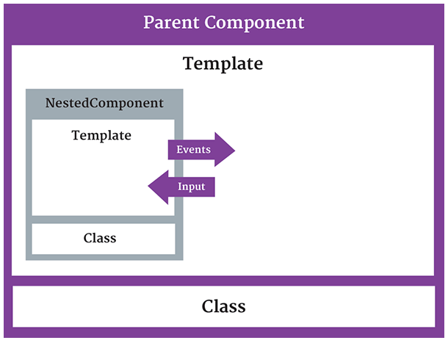
Nested Components
When a component has another component, its possible to pass data to and from a nested component in Angular 2/4.

Slide 104
@Input
Nested component can receive input data from parent component using @Input decorator
Below is definition of Nested component
@Component({
selector: 'child-selector',
template: 'child.component.html'
})
export class ChildComponent
{
@Input() title:string;
}
Name of Attribute, which need to be used with child-selector directive

Slide 105
How Parent component passes data to Nested Component.
Below is code snippet of Parent Template
<div>
<h1>I'm a container component</h1>
<child-selector [title]='childTitle'></child-selector>
</div>

Slide 106
How Nested component can send data to Parent Component.
This can be achieved using @Output decorator. This data is received by Parent Component as a Event
Below is snippet of Nested Component
@Component({
selector: 'child-selector',
template: 'child.component.html'
})
export class ChildComponent
{
@output() notify: EventEmitter<string> = new EventEmitter<string>();
onClick() { this.notify.emit('Click from nested component'); }
}

Slide 107
Parent component template
<div>
<h1>I'm a container component</h1>
<child-selector (notify)='onNotify($event)>
</child-selector>
</div>
@Component({
selector: 'parent-selector',
template: 'parent.component.html',
directives: [ChildComponent] })
export class ParentComponent { onNotify(message:string):void { alert(message); }
}

Slide 108
Component Inheritance
Component Inheritance in Angular 2.3 covers all of the following:
Metadata (decorators): metadata (e.g. @Input(), @Output), etc. defined in a derived class will override any previous metadata in the inheritance chain otherwise the base class metadata will be used.
Constructor: the base class constructor will be used if the derived class doesn’t have one, this mean that all the services you injected in parent constructor will be inherited to child component as well.
Lifecycle hooks: parent lifecycle hooks (e.g. ngOnInit, ngOnChanges) will be called even when are not defined in the derived class.
Component inheritance DO NOT cover templates and styles. Any shared DOM or behaviours must be handled separately.
extends is the keyword used

Slide 109
Template Swapping
Angular components are a fantastic way to break up our web apps into small & easy to understand pieces of UI code.
In some cases, we want to display same data, in different Formats. For example
in mobile and desktop layouts.
in list view and table view.
In these cases it would be really helpful to be able to swap the templates when displaying the data in different formats.
We can achieve Template Swapping using Angular Component Inheritance.

Slide 110
What is Observable?
An observable data service is an Angular 2 injectable service that can be used to provide data to multiple parts of the application.
The service, usually named a store, can be injected anywhere the data is needed.
You can think of an observable as an array whose items arrive asynchronously over time. Observables help you manage asynchronous data, such as data coming from a backend service. Observables are used within Angular itself, including Angular’s event system and its http client service. To use observables, Angular uses a third-party library called Reactive Extensions (RxJS). Observables are a proposed feature for ES 2016, the next version of JavaScript.
How to Use an Observable Data Service
The data service exposes an observable, for example, TodoStore exposes the todos observable. Each value of this observable is a new list of todos.
The data service can then be used directly in the templates using the async pipe
giving us the ability to maintain integrity of the type of data we are expecting to receive.
This follows Observer Design pattern

Slide 111
What is Observable?
The observer pattern is a software design pattern in which an object, called the subject, maintains a list of its dependents, called observers, and notifies them automatically of any state changes, usually by calling one of their methods. It is mainly used to implement distributed event handling systems.
The problem with Promises is that they are neither cancellable nor are they a good way to manage collections of data

Slide 112
Observable - How to Modify data
The data in stores is modified by calling action methods on them, for example:
onAddTodo(description) {
this.todoStore.addTodo(newTodo)
.subscribe(
res => {},
err => {
this.uiStateStore.endBackendAction();
}
);
}
The data store will then emit a new value for its data depending on the action method call, and all subscribers will receive the new value and update accordingly.

Slide 113
Subject
We can subscribe to the Subject and we can manually trigger the next() method. When you call the next() method every subscriber will get this value. (you can also trigger error() and complete())
error(): sends a Javascript error or exception
complete(): does not send any value to subscribers.

Slide 114
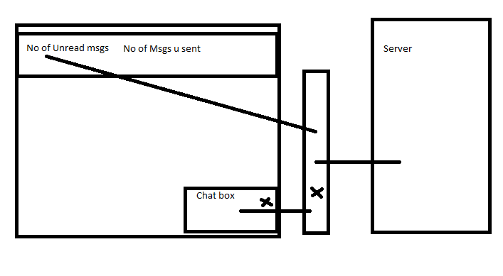
Observable - How to Modify data

Slide 115
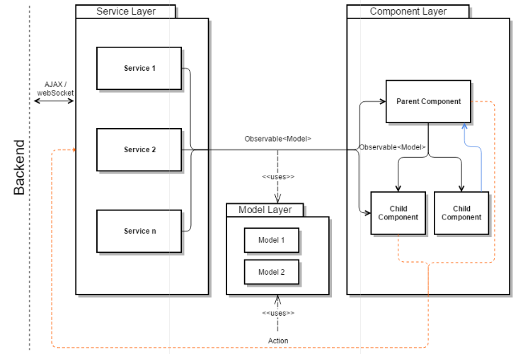
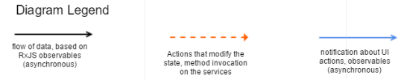
Observable Diagram

Slide 116
Benefit From Observables
Using Observable pattern provides the following key benefits while developing complex web applications:
Provides an easy-to-use event-like abstraction layer where Observable emissions are synonymous with events
Helps develop asynchronous, user-interactive applications efficiently
Enables a simple communication mechanism across different parts of the Client application without introducing explicit tight dependencies between components
Minimize API calls to Back end, there by saving N/W bandwidth & Processing on Server side

Slide 117
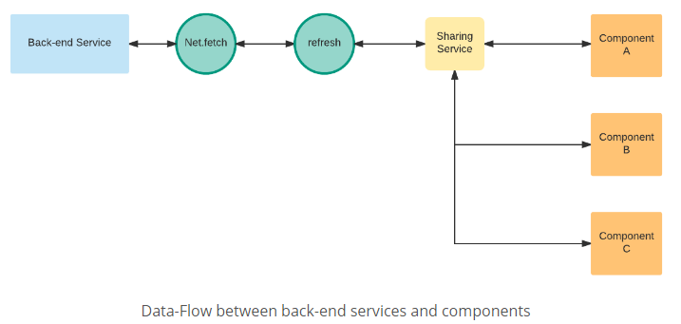
Observable Data Flow

Slide 118
Promise and Observable Comparison
Promise and Observable Comparison

Slide 119
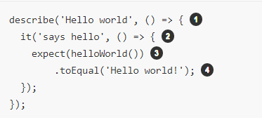
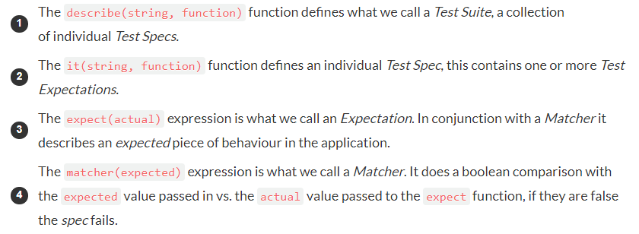
Unit Test Angular JS2 using Jasmine

Slide 120
Unit Test Angular JS2 using Jasmine
describe( ) wraps a block of related tests. It takes a descriptive name, and a function that executes when your tests run.
beforeEach( ) sets up preconditions, and will run before each and every test in its block. It takes a function, and is meant to be used inside describe blocks – it should be a direct child of a describe.
it( ) creates a test. it takes a descriptive name and a function to run, and it should be nested as a direct child of a describe block.

Slide 121
Unit Test Angular JS2 using Jasmine
expect( ) is a Jasmine expectation, and is meant to be used inside an it block. It allows you to make assertions. If any assertions in a test fail, the test will fail. If a test has no assertions in it, it will pass automatically.
.toEqual( ) is a Jasmine matcher. There are a number of such Matchers provided by Jasmine

Slide 122
Jasmine Setup and Teardown
Sometimes in order to test a feature we need to perform some setup, perhaps it’s creating some test objects.
Also we may need to perform some cleanup activities after we have finished testing, perhaps we need to delete some files from the hard drive.
These activities are called setup and teardown (for cleaning up) and Jasmine has a few functions we can use to make this easier:
beforeAll( ) This function is called once, before all the specs in describe test suite are run.
afterAll( ) This function is called once after all the specs in a test suite are finished.
beforeEach( )This function is called before each test specification, it function, has been run.
afterEach( ) This function is called after each test specification has been run.

Slide 123
Jasmine Builtin Matchers
expect(array).toContain(member); expect(fn).toThrow(string); expect(fn).toThrowError(string); expect(instance).toBe(instance); expect(mixed).toBeDefined(); expect(mixed).toBeFalsy(); expect(mixed).toBeNull(); expect(mixed).toBeTruthy(); expect(mixed).toBeUndefined(); expect(mixed).toEqual(mixed); expect(mixed).toMatch(pattern); expect(number).toBeCloseTo(number, decimalPlaces); expect(number).toBeGreaterThan(number); expect(number).toBeLessThan(number); expect(number).toBeNaN(); expect(spy).toHaveBeenCalled(); expect(spy).toHaveBeenCalledTimes(number); expect(spy).toHaveBeenCalledWith(...arguments);

Slide 124
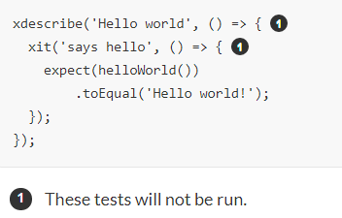
Disabled and focused tests
You can disable tests without commenting them by just pre-pending x to the describe or it functions, like below:

Slide 125
Why Karma is used with Jasmine?
Without using Karma, and by using Jasmine you need to manually open Browser, and Test, which is time consuming.
Karma is a tool which lets us spawn browsers and run jasmine tests inside of them all from the command line. The results of the tests are also displayed on the command line.
Karma can also watch your development files for changes and re-run the tests automatically.
Karma lets us run jasmine tests as part of a development tool chain which requires tests to be runnable and results inspectable via the command line.

Slide 126
End to End(e2e) Testing
In Unit Testing, individual Components or Services are Tested.
In End to End Testing, entire Scenario is tested end to end.
For End to End Testing(e2e), protractor is used
The command used to run is ng e2e
End to end tests are located in the folder e2e
E2E tests also are written using jasmineframework
each of the files need to end with the word e2e-spec.ts so that the protractor test runner can pick up the test files.

Slide 127
e2e Testing
API Documentation for Protractor is http://www.protractortest.org/#/api

Slide 128
Debugging Angular 2 App
Debugging can be done on Chrome Browser using Augury Extension Tool to your Chrome Browser
To install Augury, on Chrome Browser visit , http://augury.angular.io and click Install button.
To put Break Points, add the statement debugger; to your ts file. This debugger; works only in Dev Mode, and not in Production Mode.
Break Point can also be put, in source window of Chrome Browser

Slide 129
Debugging Angular 2 App
To debug using Augury, run the App normally using ng serve –open
Once Browser window gets opened, you need to manually open Augury Window, by pressing F12 and selecting Augury tab.
Execution gets paused, whenever the source code with Breakpoint is hit. At this point of time, you can
Step thru or over statements in .ts file
view call Stack
View variables, etc…

Slide 130
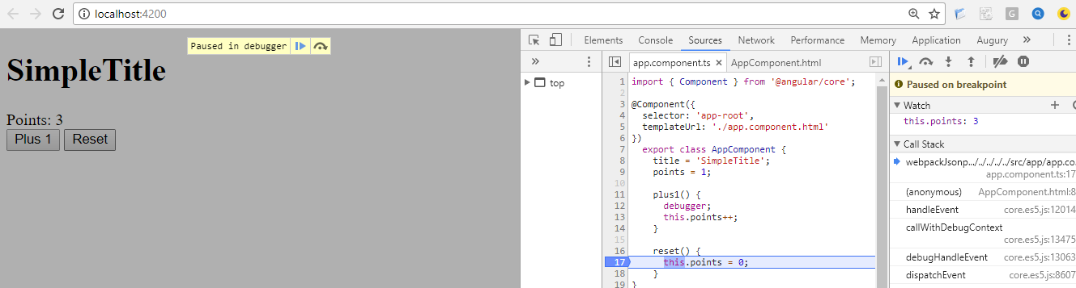
Debugging Angular 2 App
Resize/zoom below image, to view details

Slide 131
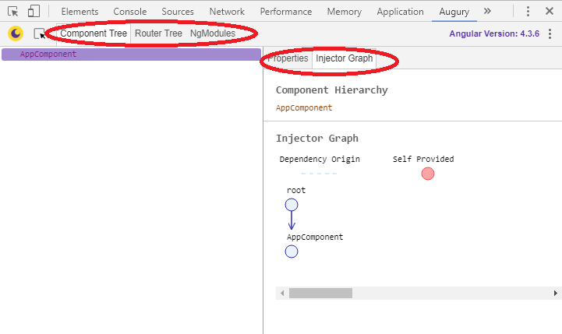
Debugging Angular 2 App
Using Augury you can also, as shown in below image
View Properties of a Component
View Injector Graph
View Router Tree
View Modules used by App

Slide 132
Error Handling
https://medium.com/@amcdnl/global-error-handling-with-angular2-6b992bdfb59c

Slide 133
Routing
It is Quite common that Web pages need Navigation, to Navigate between various Web Pages.
Angular provides inbuilt support for the same using Routing feature, and Developer need to add only minimal implementation for the same

Slide 134
Routing
Routing helps in directing users to different pages based on the option they choose on the main page.
Based on the option user chooses, a specific Angular Component will be rendered to the user.
Step1:
All Routes need to be specified, as below, in app.routes.ts file
import { Routes } from '@angular/router';
import { AboutComponent } from 'app/about.component';
import { HomeComponent } from 'app/home.component';
export const routes: Routes = [
{ path: '', component: HomeComponent }
{ path: 'about', component: AboutComponent } ];

Slide 135
Routing
Step 2:Specify routes List in Root Module
import { RouterModule } from '@angular/router';
import { routes } from './app.routes';
@NgModule
({
imports: [ BrowserModule, FormsModule, RouterModule.forRoot(routes) ],
declarations: [ AboutComponent, HomeComponent, AppComponent ],
providers: [ ],
bootstrap: [ AppComponent ]
})
export class AppModule { }

Slide 136
Routing
Step 3: [routerLink] directive generates our link based on the route path.
<router-outlet></router-outlet> is the placeholder to render the component based on which option the user chooses
@Component
({
selector: 'demo-app',
template: ` <a [routerLink]="['/']">Home</a>
<a [routerLink]="['/about']">About</a>
<router-outlet></router-outlet> `
})
Displays links
Router-outlet is replaced with currently selected Component Template

Slide 137
Routing
Step 4: Create the other Components which are associated with links. In this case, they are AboutComponent, HelpComponent
No special implementation is required in these components, only thing is they need to have same name as specified in Routers array

Slide 138
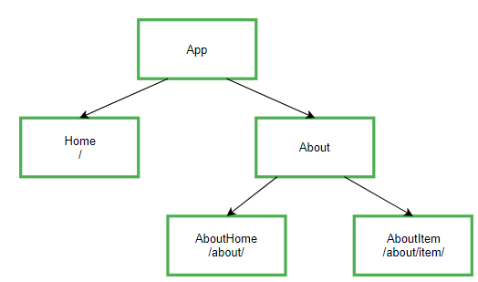
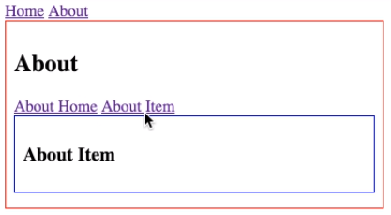
Nested Routing
As shown beside, Child/Nested routing is a feature in Angular router.
It has a tree structure, components nested in more components.

Slide 139
LifeCycle Hooks
Angular 2 application goes through an entire set of processes or has a lifecycle right from its initiation to the end of the application
Below are various Component LifeCycle Hooks/Call backs invoked at various stages.
You can override zero or more Hooks, for your component, based on your requirement
ngOnChanges – When the value of a data bound property changes, then this method is called.
ngOnInit – This is called whenever the initialization of the directive/component after Angular first displays the data-bound properties happens.
ngDoCheck – This is for the detection and to act on changes that Angular can't or won't detect on its own.
ngAfterContentInit – This is called in response after Angular projects external content into the component's view.
ngAfterContentChecked - This is called in response after Angular checks the content projected into the component.

Slide 140
LifeCycle Hooks
ngAfterViewInit - This is called in response after Angular initializes the component's views and child views.
ngAfterViewChecked - This is called in response after Angular checks the component's views and child views.
ngOnDestroy – This is the cleanup phase just before Angular destroys the directive/component.
Example:
https://alligator.io/angular/lifecycle-hooks/

Slide 141
How to debug AngularJS 2 Applications?
npm install --save angular2-logger

Slide 142
Component Inheritance
In AngularJS2/4 it is possible to inherit one Component from another Component
Here, you can use Basic functionality of Base Component, and can override or add functionality of your own.
For eg:
export class VehicleComponent extends BusComponent
{
}

Slide 143
Angular 2/4 Dependency Injection
Dependency Injection is a design pattern which passes an object as dependencies in various components across the application.
Advantage of DI is Loose Coupling between Dependencies
It creates a new instance of class along with its necessary dependencies.
Dependency Injection is stimulated into the framework and can be used anywhere.
How Angular 2/4 supports Dependency Injection:
Injector mechanism maintains service instance which is created using a provider.
Provider is a way to create a service.
User can register providers along with injectors.

Slide 144
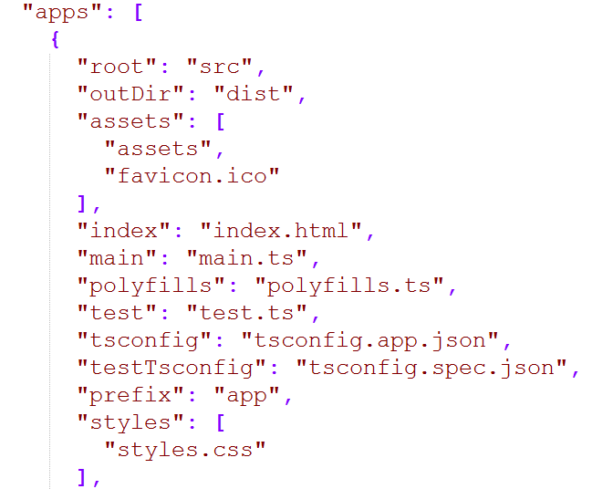
Structure of Application
.angular-cli.json - file with complete details of Application Configuration, like main file name, tsc compiler configurations file, etc…
Main file name

Slide 145
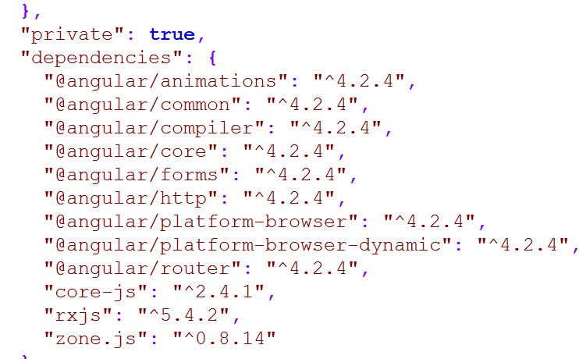
Packages.json
Specifies application name, project dependency and dev dependencies packages along with the corresponding versions
Package Versions

Slide 146
Tsconfig.json
Configurations for TSC Compiler. Complete list of Configurations are inhttps://www.typescriptlang.org/docs/handbook/compiler-options.html
tsconfig.app.json - TSC Compiler Conifgurations for Application code
tsconfig.spec.json - TSC Compiler Conifgurations for Testing related code

Slide 147
Others
Main.ts – execution of Application starts from here
Test.ts – Test execution starts from here
NOTE: Above names need to be specified in .angular-cli.json file

Slide 148
Angular CLI
Angular CLI(Command Line Interface) is a great tool to create and work with Angular Applications .
It takes away all the pain staking work one has to do otherwise manually by making all the configuration files required for bootstrapping an angular application.
With few commands it generates skeletons(using code generator) and is easier to build working components, Services, directives etc .

Slide 149
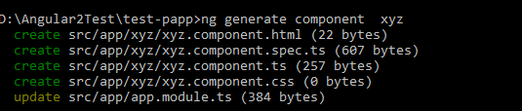
Generally used Angular CLI commands
command | purpose
ng serve –open | To run dev server and launch app (--port can be used to specify port number other than 4200)
ng test | To execute test cases
ng build | To build the app. use `-prod` flag for a production build. dist folder gets generated after this step
ng help | For help and more details
ng eject nglint | ejects your app and output the proper webpack configuration and scripts. To lint Angular Application
ng e2e | serves the application and runs end-to-end tests
ng generate component component-name | To generate a new component. Similary you can generate directive or pipe or service or class, interface, module

Slide 150
Angular CLI Generate commands
command | purpose
ng g pipe my-new-pipe | To create Pipe
ng g service my-new-service | To create new Service
ng g class my-new-class | To create a Class
ng g interface my-new-interface | To create an Interface
ng g module my-module | To create a Module

Slide 151
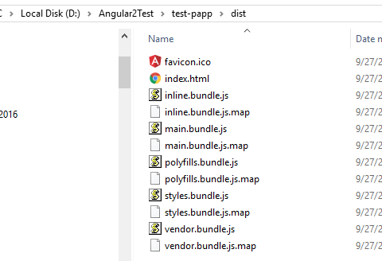
Contents of Dist folder
.map files provides mapping between actual identifiers and minified names

Slide 152
AngularJS2 Animations
Angular 2 allows you to integrate animations in your apps easily, along with a lot of flexibility.
Below are steps
The Component meta-data does not end with just selectors, templates, and styles.
There is one more meta-data called animations.
animations is an array of declarative animations that we intend to apply to our component:
Define Trigger, with different states and transitions, as shown in below snippet

Slide 153
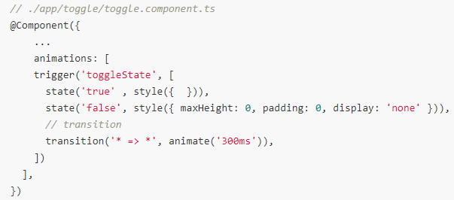
AngularJS2 Animations

Slide 154
AngularJS2 Animations…
trigger -trigger Creates an animation trigger which will a list of state and transition entries that will be evaluated when the expression bound to the trigger changes.
state declares an animation state within the given trigger. When a state is active within a component then its associated styles will persist on the element that the trigger is attached to
transition declares the sequence of animation steps that will be run when the provided stateChangeExpr value is satisfied.
animate specifies an animation step that will apply the provided styles data for a given amount of time based on the provided timing expression value.

Slide 155
Third Party Angular 2/4 Components
Support for 3rd party lib via command is still not supported.
Do the following to add Wxyz component:
npm install Wxyz
copy Wxyz .js from node_modules/moment to src/assets/js/Wxyz.js
include assets/js/ Wxyz.js in your index.html
install the typings and import lib to your .ts file where you need it
run ng serve and enjoy using Wxyz, in your .ts files by importing

Slide 156
Drag & Drop with ng2-dragula
https://www.npmjs.com/package/ng2-drag-drop

Slide 157
Angular 2 Maven Build
Quite often you may need to use Angular 2 app within Java Project. As known Maven is popular Java Build & Deployment Tool.
So how can we add Angular 2 App building and copied to a directory(so that these files can be picked to further create war file)
So how can we invoke Angular CLI commands from Maven pom file?

Slide 158
Angular 2 Local Storage(TBD)
The standard localStorage API should be available, just do e.g.:
localStorage.setItem('whatever', 'something'); It's pretty widely supported.
Note that you will need to add "dom" to the "lib" array in your tsconfig.json if you don't already have it.

Slide 159
Angular 2 Gulp
Angular Applications can also be build using Gulp, instead of Angular CLI
Below are advantages of using Gulp, instead of CLI
Flexibility of using SASS or LESS
Flexibility of using your favorite JavaScript, either CoffeScript or TypeScript
Flexiblity of using Jade Markup Language
Etc…
More details
http://www.wisdomofjim.com/blog/8-reasons-why-gulp-angular-is-my-new-favorite-angular-yeoman-generator

Slide 160
Bootstrap with Angular 2/4
Bootstrap is the most popular HTML, CSS, and JavaScript framework for web front-end development.
It’s great for developing responsive, mobile-first web sites.
Below are different ways to use Bootstrap with Angular 2
#1. Specify Bootstrap url in index.html
<!doctype html>
<html>
<head>
<link rel="stylesheet" href="https://maxcdn.bootstrapcdn.com/bootstrap/3.3.7/css/bootstrap.min.css" >
</head>
<body>
<app-root>Loading...</app-root>
<script src="https://code.jquery.com/jquery-3.1.1.min.js"></script>
<script src="https://maxcdn.bootstrapcdn.com/bootstrap/3.3.7/js/bootstrap.min.js"></script>
</body>

Slide 161
Bootstrap with Angular 2/4
#2. Adding Bootstrap Via NPM
Another way to add Bootstrap to your Angular project is to install it into your project folder by using NPM.
$ npm install bootstrap@3 jquery –save
by adding the file paths to the styles and scripts array in file .angular-cli.json:
"styles": [
"styles.css",
"../node_modules/bootstrap/dist/css/bootstrap.min.css"
],
"scripts": [
"../node_modules/jquery/dist/jquery.min.js",
"../node_modules/bootstrap/dist/js/bootstrap.min.js"
],

Slide 162
Bootstrap with Angular 2/4
#3. Using Ng-Bootstrap
Ng-Bootstrap contains a set of native Angular directives based on Bootstrap’s markup and CSS. As a result no dependency on jQuery or Bootstrap’s JavaScript is required. Ng-Bootstrap is based on Bootstrap 4 and can be added to your Angular project is the following way.
Ng-Bootstrap is available as a NPM package, so the installation can be done by using the following command in the project directory:
npm install --save @ng-bootstrap/ng-bootstrap
Furthermore Ng-Bootstrap required Bootstrap 4 to be added to our project. Install it via:
$ npm install bootstrap@4.0.0-alpha.6

Slide 163
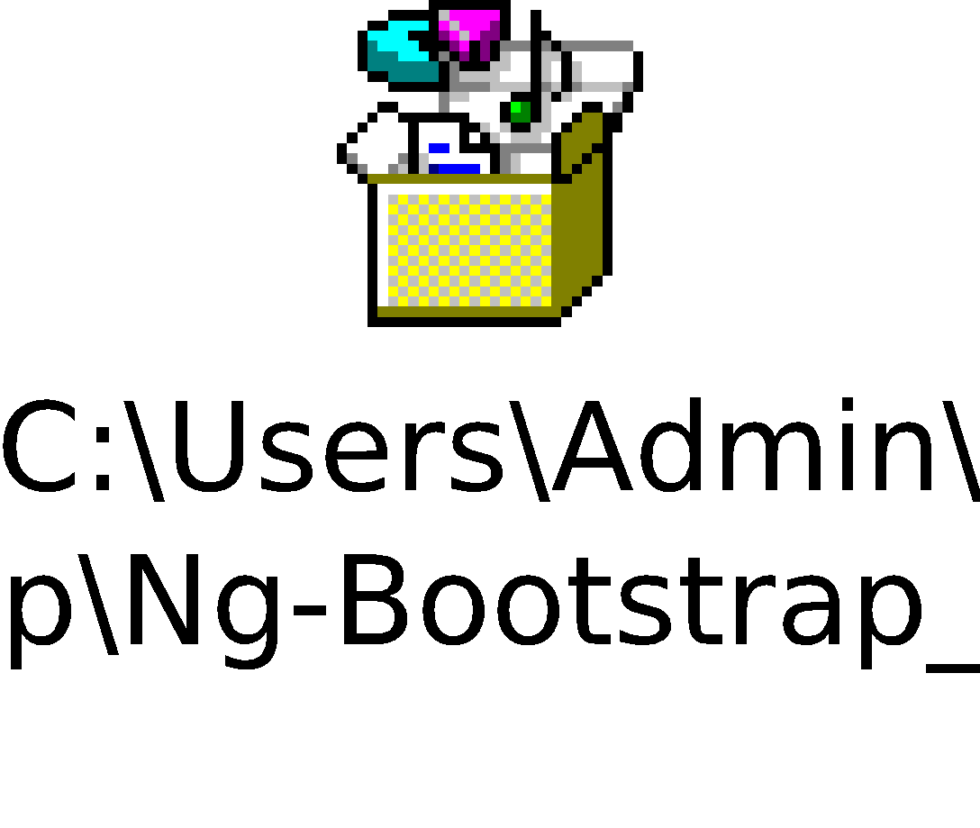
Bootstrap with Angular 2/4
Ng-Bootstrap Components
Having imported NgbModule in your Angular application you can now make use of the Ng-Bootstrap components in your templates. The following components are available:
Accordion
Alert
Buttons
Collapse
Datepicker
Dropdown
Modal
Pagination, etc…
Bootstrap with Angular 2 Code snippet

Slide 164
Angular 2/4 for Mobile Applications
Angular 2 can be used to develop Hybrid Mobile Applications using
Ionic
Native Script

Slide 165
Angular 2/4 Reactive forms
In Reactive forms we don’t rely heavily on template for structuring our forms rather we use the underlying API’s exposed by angular which is called the Reactive API and can be used by importing a module called ReactiveModule to create the forms.
This way we can very easily get rid of the declarative nature of the template forms and also the near to impossible testability of the template forms.
It also makes the logic sit in one place does not clutter the form template file which can sometimes grow insanely big at times.

Slide 166
Angular 2/4 FormGroup, FormControl
Form Control
FormControl are the basic building blocks of a reactive form or a form in general. Think of them as input box, select box, radio buttons, dropdown etc.
Form Group
FormGroup is a collection/group of FormControls. It also offers many api’s such as tracking validity and values of the whole formGroup.

Slide 167
Angular 2/4 Form Control state
form control instance on our model encapsulates state about the control itself, such as if it is currently valid or if it’s been touched.
myform.controls.email.dirty - dirty is true if the user has changed the value of the control.
The opposite of dirty is pristine
myform.controls.email.pristine - true if the user hasn’t changed the value
myform.controls.email.touched touched is true of the field has been touched by the user, otherwise it’s false.
The opposite of touched is the property untouched.

Slide 168
Angular 2/4 Form Control state
myform.controls.email.invalid
This would be true if the control was invalid and false if it was valid.
Examples:
myform.controls.email.valid && myform.controls.email.dirty

Slide 169
Angular 2/4 Validators
Validators are rules which an input control has to follow. If the input doesn’t match the rule then the control is said to be in invalid state.
We can apply validators either by adding attributes to the template or by defining them on our FormControls in our model.
first parameter of a FormControl constructor is the initial value of the control. The second parameter contains either a single validator, or an array of multiple validators.
Example: https://www.concretepage.com/angular-2/angular-2-formcontrol-example

Slide 170
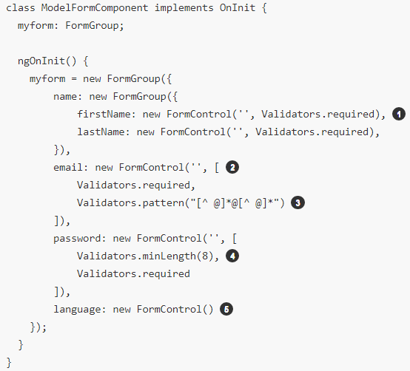
Angular 2/4 Validators
Initial value of FormControl
Single Validator
Array of multiple Validators

Slide 171
Angular 2/4 Validators
Angular4 automatically adds novalidate in ngForm (your form tag) by default.
As known, novalidate disables HTML5 native browser validation.
If you want to enable HTML5 validation, add Angular's ngNativeValidate attribute in your form tag.

Slide 172
Angular 2/4 Advantages of Module Driven Forms

Slide 173
Angular 4 New Features
Smaller and Faster:
With Angular 4, programs will consume less space and run quicker than previous versions. (Nearly 60% reduction in size)
View Engine:
They have made adjustments under to hood to exactly what AOT created code looks like. These modifications decrease the size of the generated code for those parts by approximately 60 percent.
Animation Package:
They've pulled animations from the Angular core and set them in their own package. This means that in case you don't use animations, this excess code won't end up on your creation packages.
You may add animations to the main NgModule by importing the Browser Animations Module out of @angular/platform-browser/animations.

Slide 174
Angular 4 New Features
Improved *ngIf and *ngFor:
The template binding syntax currently supports a few helpful alterations. Now you can utilize an if/else design syntax, and assign local variables like if to unroll an observable.
TypeScript 2.1 and 2.2 Compatibility:
The group has upgraded Angular into a more recent version of TypeScript. This will enhance the rate of ngc and you'll receive far better type checking during your program.
Source Maps for Templates:
Now whenever there's an error caused by something in one of the templates, they create source maps that provide a meaningful context concerning the original template.

Slide 175
How to display Font Awesome Icons
Method 1: Include below in index.html
<link rel="stylesheet" href="//maxcdn.bootstrapcdn.com/font-awesome/4.5.0/css/font-awesome.min.css">
Then directly use font-awesome styles, such as below in any HTML Template
<i class="fa fa-camera-retro fa-5x"></i>
Method 2:
https://code.i-harness.com/en/q/29ce694

Slide 176
Angular JWT Token Storage
Application login & login session using JWT Token
NOTE: JWT Token need to be stored in session or local storage persistently
https://www.devglan.com/spring-security/angular-jwt-authentication
Angular to Spring Boot end to end example
https://www.devglan.com/spring-boot/spring-boot-angular-example

Slide 177
Sibling Component Communication
https://medium.com/@pandukamuditha/angular-5-share-data-between-sibling-components-using-eventemitter-8ebb49b64a0a
https://www.c-sharpcorner.com/article/share-data-between-sibling-components-in-angular-using-rxjs-behaviorsubject/
Angular Material Module(TBD)

